Slide 1

HLS Group Capabilities and Purpose Statement

Slide 2
Purpose Statement
The HLS Group utilizes their technical experience in statistics, data analytics, business intelligence I and modeling to provide key insights for client analysis and intel. We focus on providing data-driven business insight translating directly to economic value. In addition to capabilities in useful and applicable modeling techniques including machine learning, time series analysis, classification and regression, wEach partner brings a unique and distinguishable skillset to each of our clients, spanning differing industry knowledge and corporations.

Slide 3
Skillset
Our partners provide a wide variety of experience surrounding various technical big data analysis aspects:
Modeling
Machine Learning (Regression, Classification), Deep Learning (Deep NN, Convolutional NN, Recurrent NN), Time Series, Optimization modeling
Industry Experience
Banking (model risk management,

Slide 4

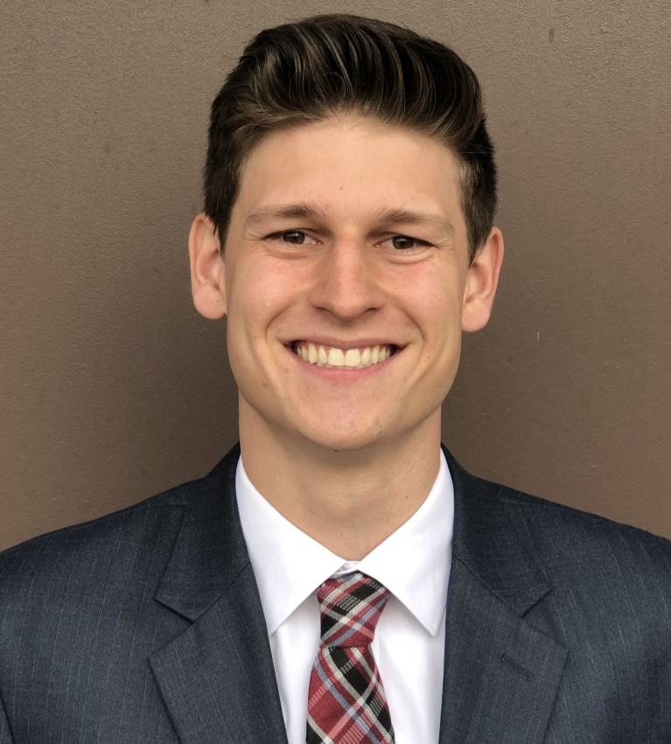
HLS Executive Board
Sam Hsiung – Managing Director/Senior Partner
Joseph Leung – Student Intern
Gabe Smith – Senior Partner

Slide 5

Sam Hsiung – Managing Director
KPMG Lighthouse:
Tableau/Business Intelligence Dashboarding
Python/Data Engineering
Fraud Detection, Cost Savings Analysis and Algorithm Design
Current State Assessment of Data Capabilities
The Boeing Company
(give details)

Slide 6

Joseph Leung – Senior Partner
Federal Reserve:
Labor Markets/Opportunity Zones related to Trump’s Tax Cuts and Job act.
Webcrawlers (add in details)
Webscrapers (add in details)
Data/Feature Engineering (add in details)
Data Analysis via Python/Stata
Bankruptcy Research
File 11 bankruptcy files and data
Household/Individual Bankruptcy
PDF Scraper/Complex Data Scraping
LP/LDA
Network Theory Research
Machine Learning
Data modeling, Community Detection

Slide 7



Gabe Smith – Senior Partner
McKinsey & Company:
Restructured entire model risk management department of major international bank
Assisted major bank finding savings opportunities for major US based bank
Quality insurance of model governance, validation and creation
John Deere & Company
Optimization Modeling of Labor Costs (Cost Structure Analysis)
Market Share prediction (modeling) and analysis (European & North Africa)
Product Warranty Prediction (Coverage Analysis via ML)
Lucid Software LLC
Anomaly Detection Algorithm: KPI detection/ Analysis
Tableau/Business Intelligence Dashboard
PPT/Excel Delivery

